Slide 1
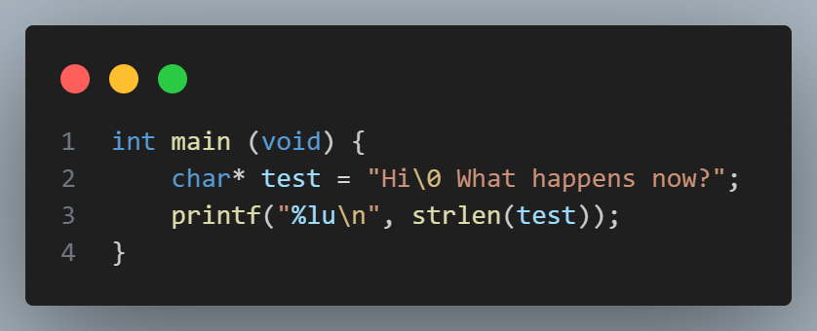
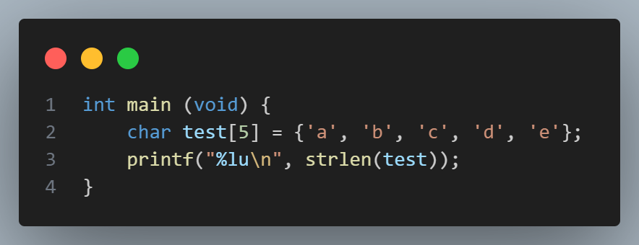
Questions before we start!
1) How might you have used arrays in PSET 1? Discuss with a partner.
2) What do you think this prints? Try it!
3) What do you think this prints? Try it!
Puzzles

Slide 2
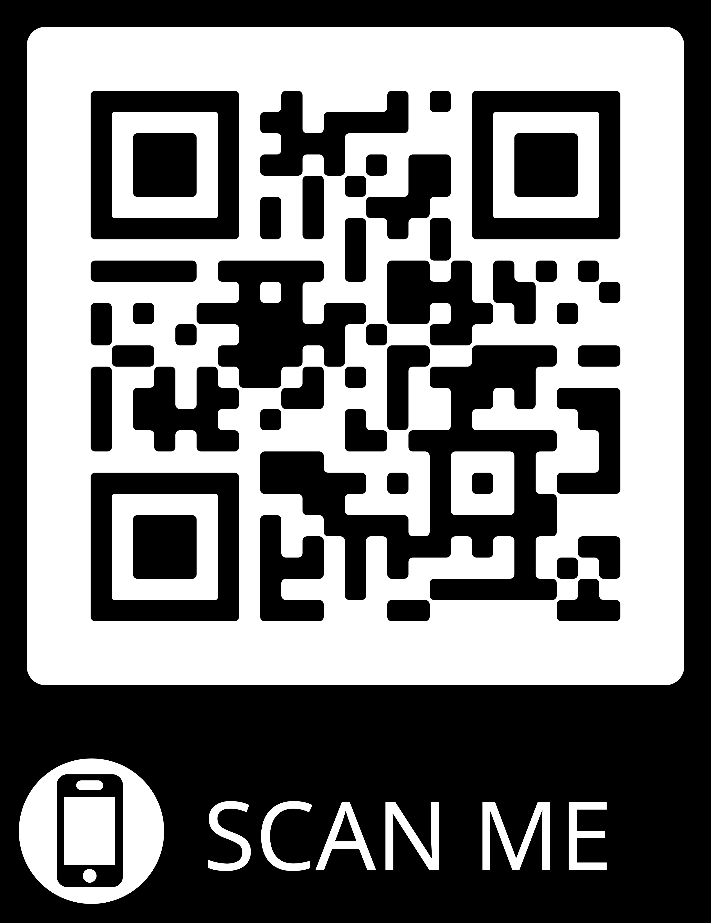
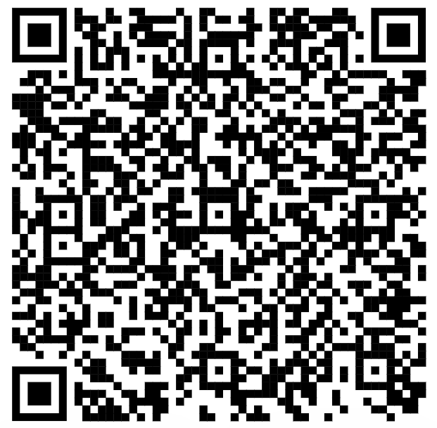
Attendance
Slack

Slide 3
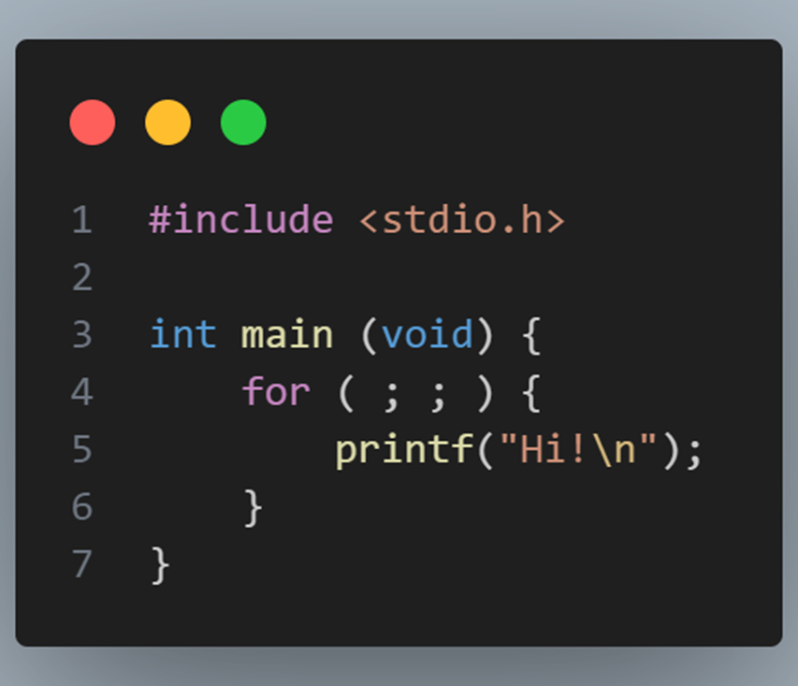
Puzzles from last time
Puzzles
1) What does this do?
2) Why?
C / for loop — DevDocs

Slide 4
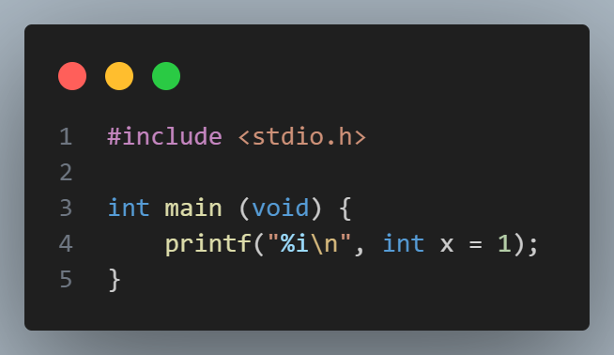
Puzzles from last time
Puzzles
1) What does this do?
2) Why?

Slide 5
cs50 section 2
Arrays!
Andrew Holmes, Fall 2023

Slide 6
Today’s plan
01
Design
03
Command Line
02
Arrays & strings!
04
PSET
Quick clean up from last week.
Argv, argc and compilers
The fun stuff!
Looking ahead!

Slide 7
01
Design

Slide 8
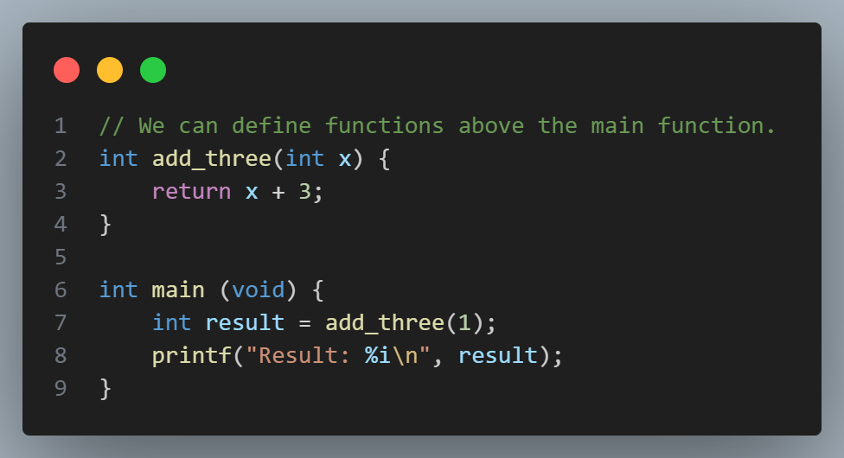
Functions
Design

Slide 9
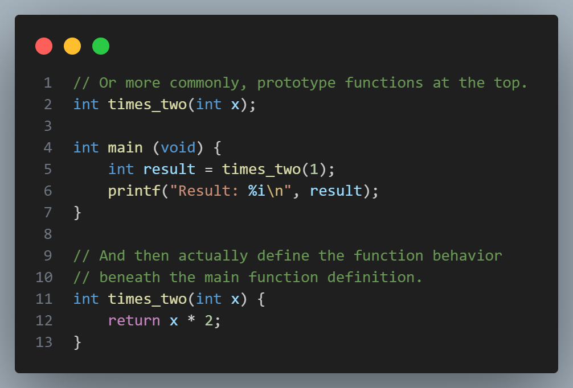
Functions
Design

Slide 10
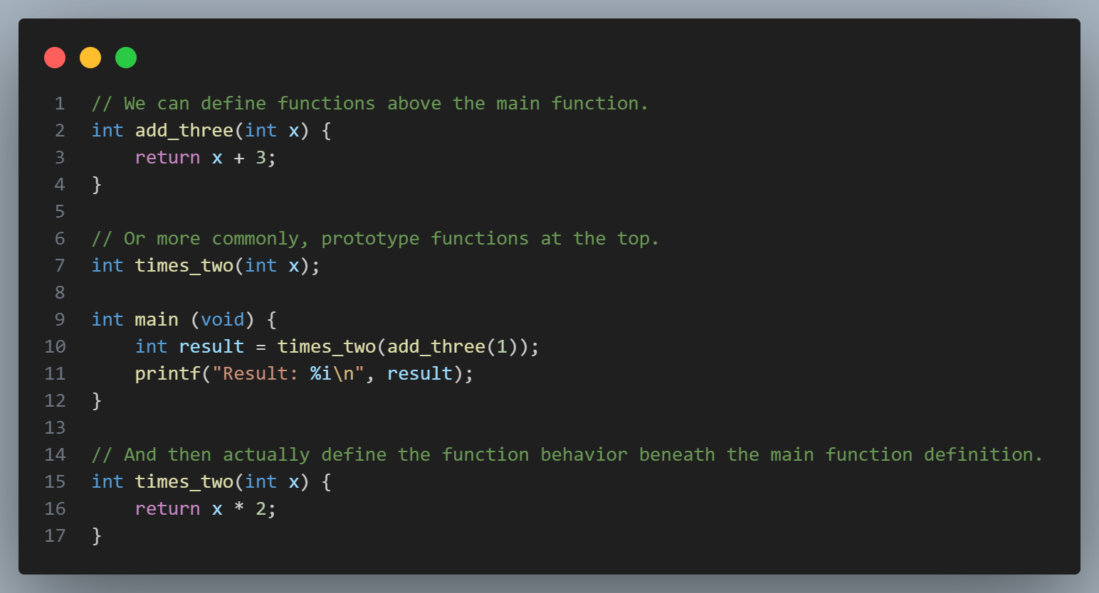
Functions
Functions

Slide 11
Functions – design thoughts
Design
Function prototypes generally preferred:
Double-enforcing/checking function typing.
Readability: main function most important, high-level overview of program.
Often don’t need to read function implementation, name and type should be informative.

Slide 12
Grading
Design
I’m most likely not grading your work, someone in my cohort will be!
3 is for good work with some minor mistakes. 4 is great. 5 is exceptional.
You can contact me if you are concerned about any grading issues.

Slide 13
Design tips
Design
Amulya’s design guide from 2022

Slide 14
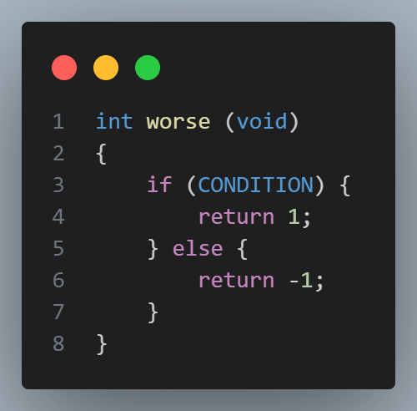
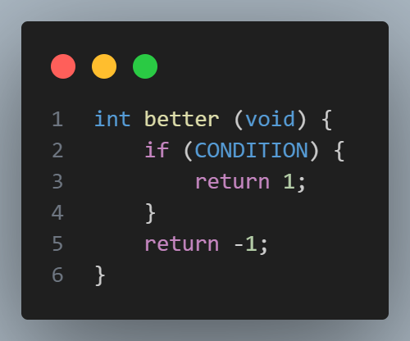
Design idea: reducing overkill ‘else’/extra indentation
Design

Slide 15
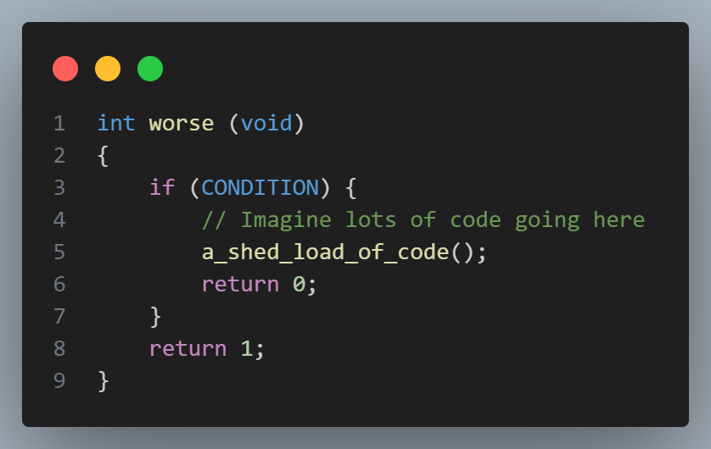
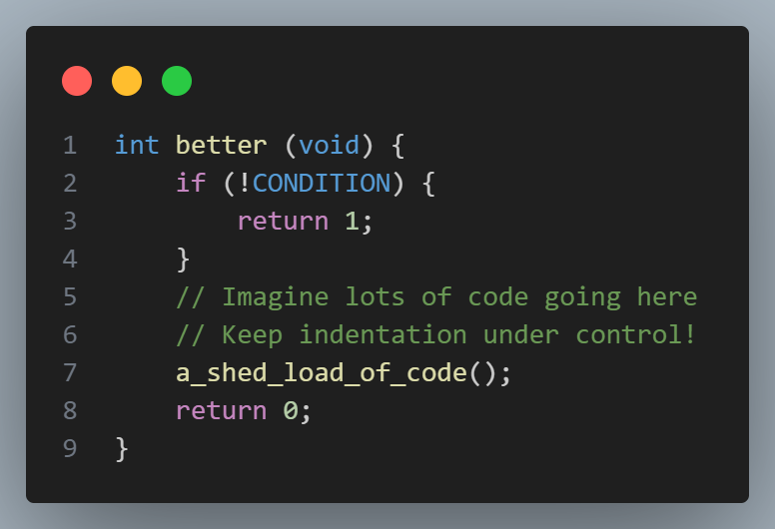
Design idea: choosing good conditions for readability
Design

Slide 16
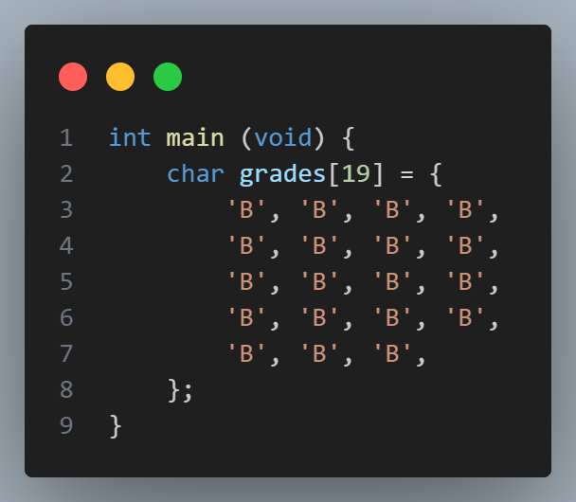
Design idea: magic numbers
Functions++

Slide 17
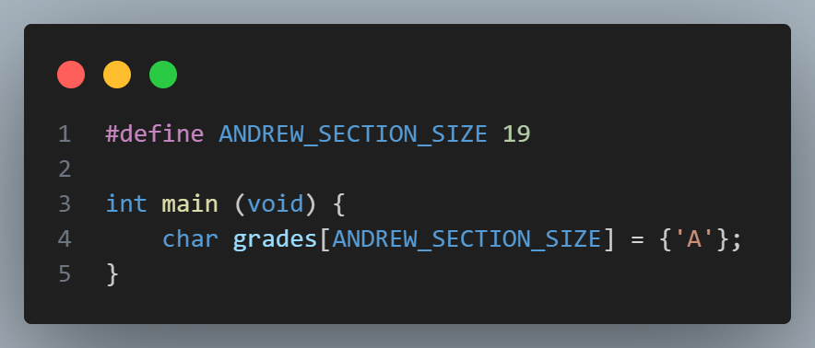
Design idea: magic numbers
Functions++
Remove ‘magic’ numbers
Array ‘syntactic sugar’.

Slide 18
02
Arrays

Slide 19
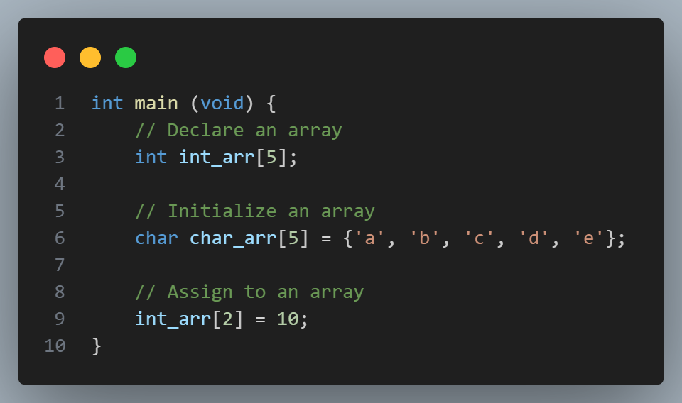
Arrays
Arrays

Slide 20
Arrays - declaration
Arrays
? | ? | ? | ? | ?
int_arr[0]
int_arr[3]

Slide 21
Arrays - declaration
Arrays
‘a’ | ‘b’ | ‘c’ | ‘d’ | ‘e’

Slide 22
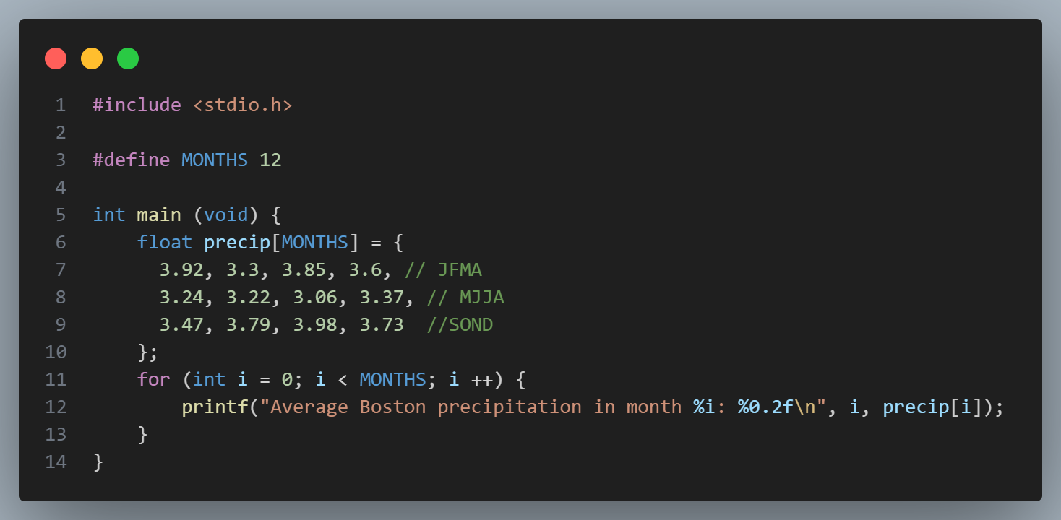
Arrays - iteration
Arrays
Arrays

Slide 23
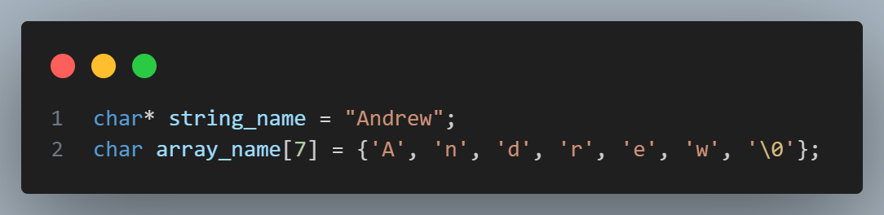
Strings – behind the hood
Arrays
‘A’ | ‘n’ | ‘d’ | ‘r’ | ‘e’ | ‘w’ | ‘\0’

Slide 24
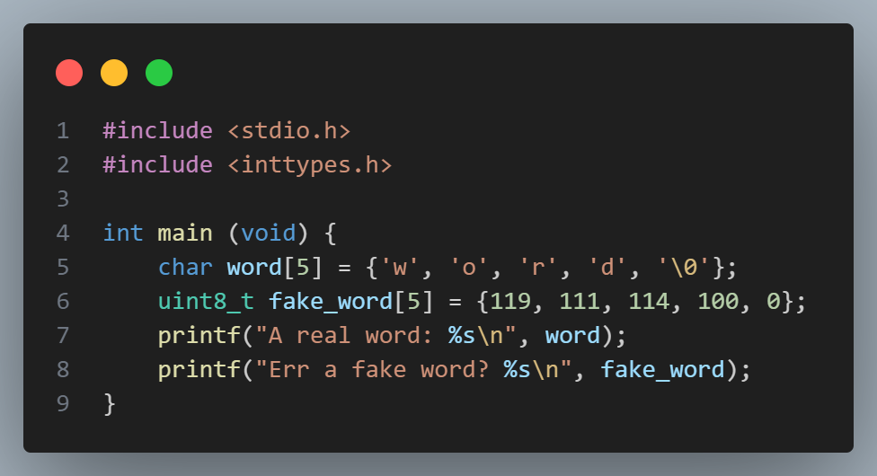
Chars – behind the hood?!
Arrays
Notes:
See ascii.c

Slide 25
Chars – behind the hood?!
Arrays
‘A’ | ‘n’ | ‘d’ | ‘r’ | ‘e’ | ‘w’ | ‘\0’
65 |  |  |  |  | 119 | 0

Slide 26
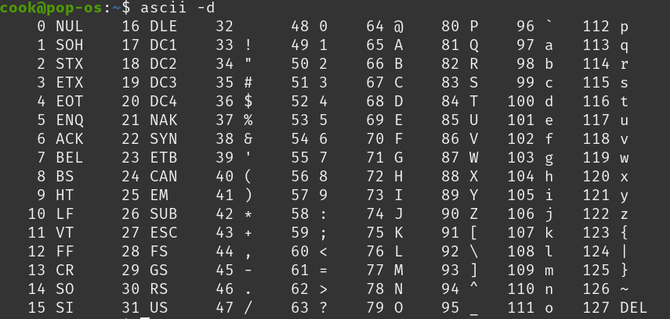
ASCII!
Arrays

Slide 27
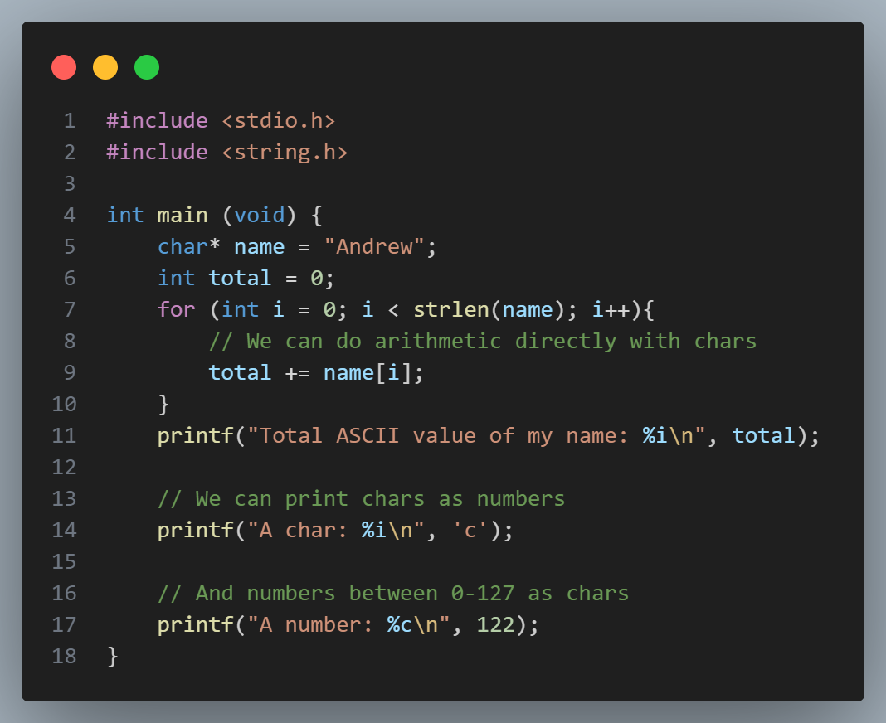
Chars vs ints (0-127)
Arrays
You can always treat a character as an unsigned integer.
You cannot always treat an integer as a character.
Notes:
See sum.c

Slide 28
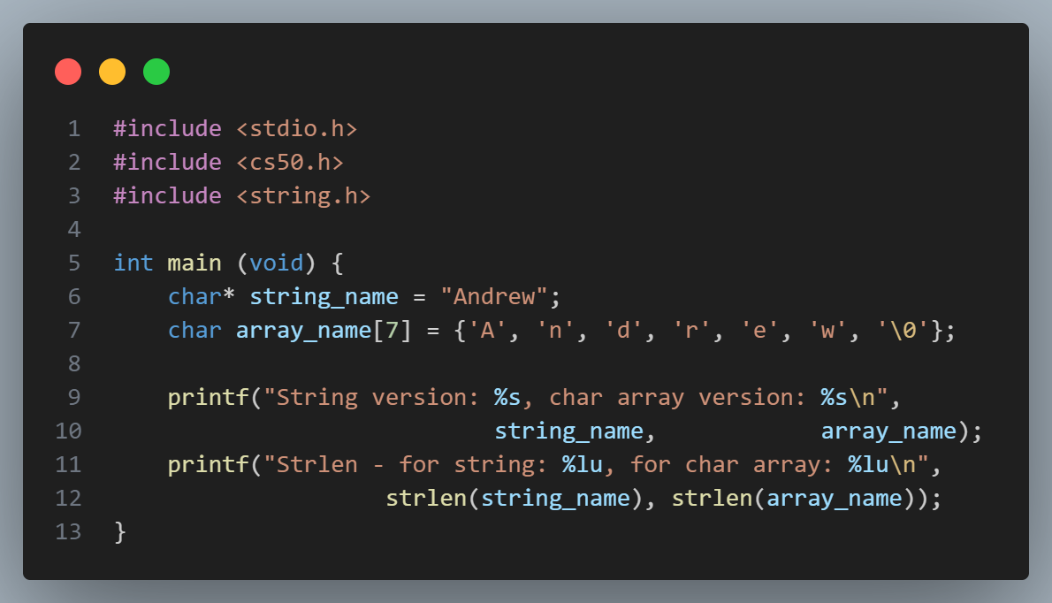
Strings
Arrays
Arrays

Slide 29

char array vs char *
Arrays
Piplup is confused. Why would you ever use the char array version, it looks much more confusing…
Investigate whether the two are equivalent!
(Try changing letters within each! Feel free to test with cs50’s string type too!)

Slide 30



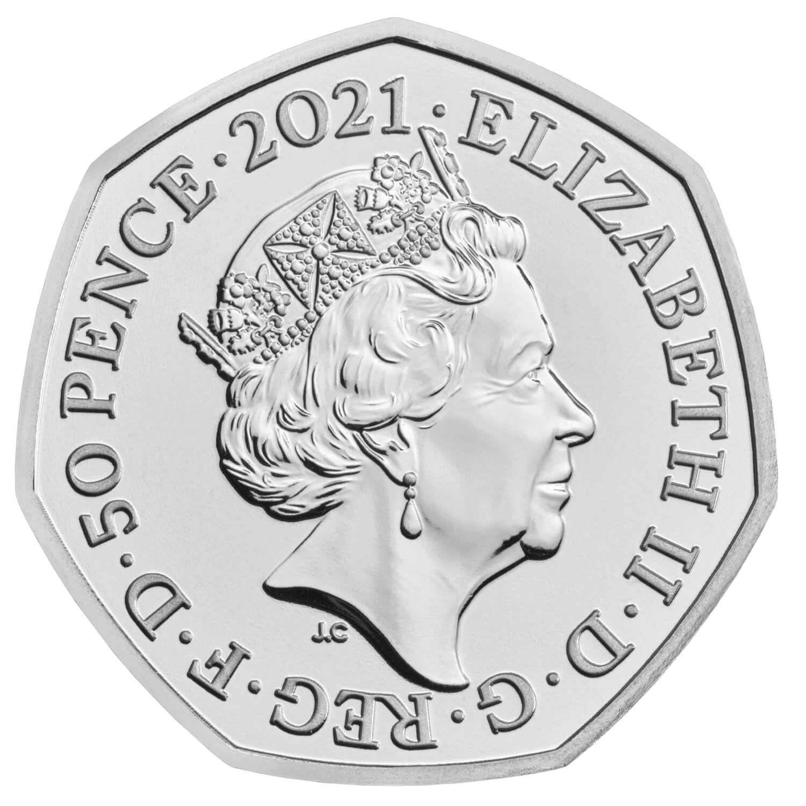

Arrays
In pairs, implement:
cash with British coins and using an array! (1p, 2p, 5p, 10p, 20p, 50p, £1, £2)
average, to find the average rainfall in Boston across the year (assume all months weighted equally, (or don’t)).
Practice!

Slide 31
03
Command Line
Command lines arguments and some thinking about compilers!

Slide 32
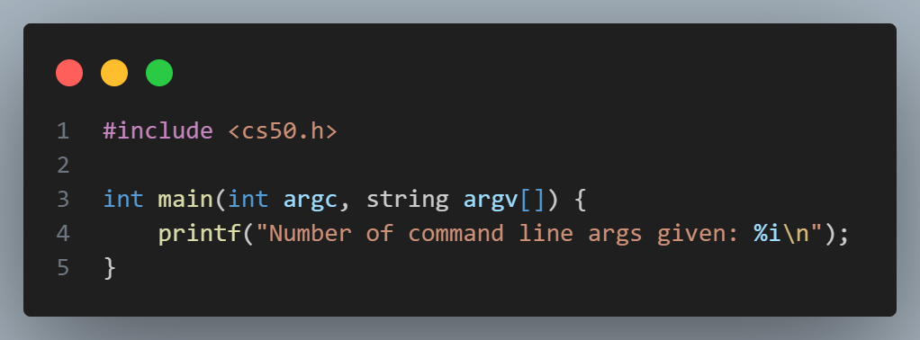
Command line arguments
Cmd-line

Slide 33
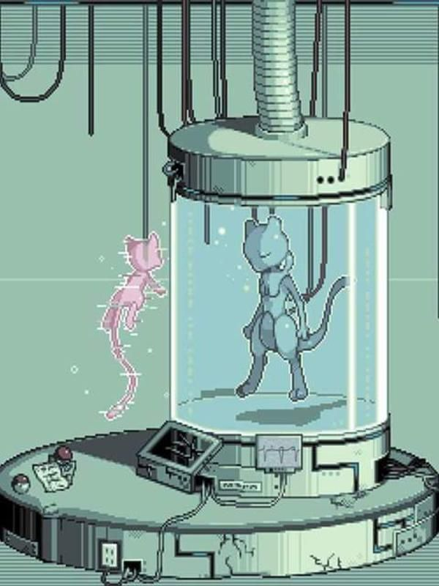
Experiment!
Cmd-line
Write some code that takes command line arguments. Try accessing them.
Can you have just argc?
Just argv?
What is argv[0]?

Slide 34

n0_v0w3ls & password
Cmd-line
See Slack channel for official cs50 practice problems!

Slide 35
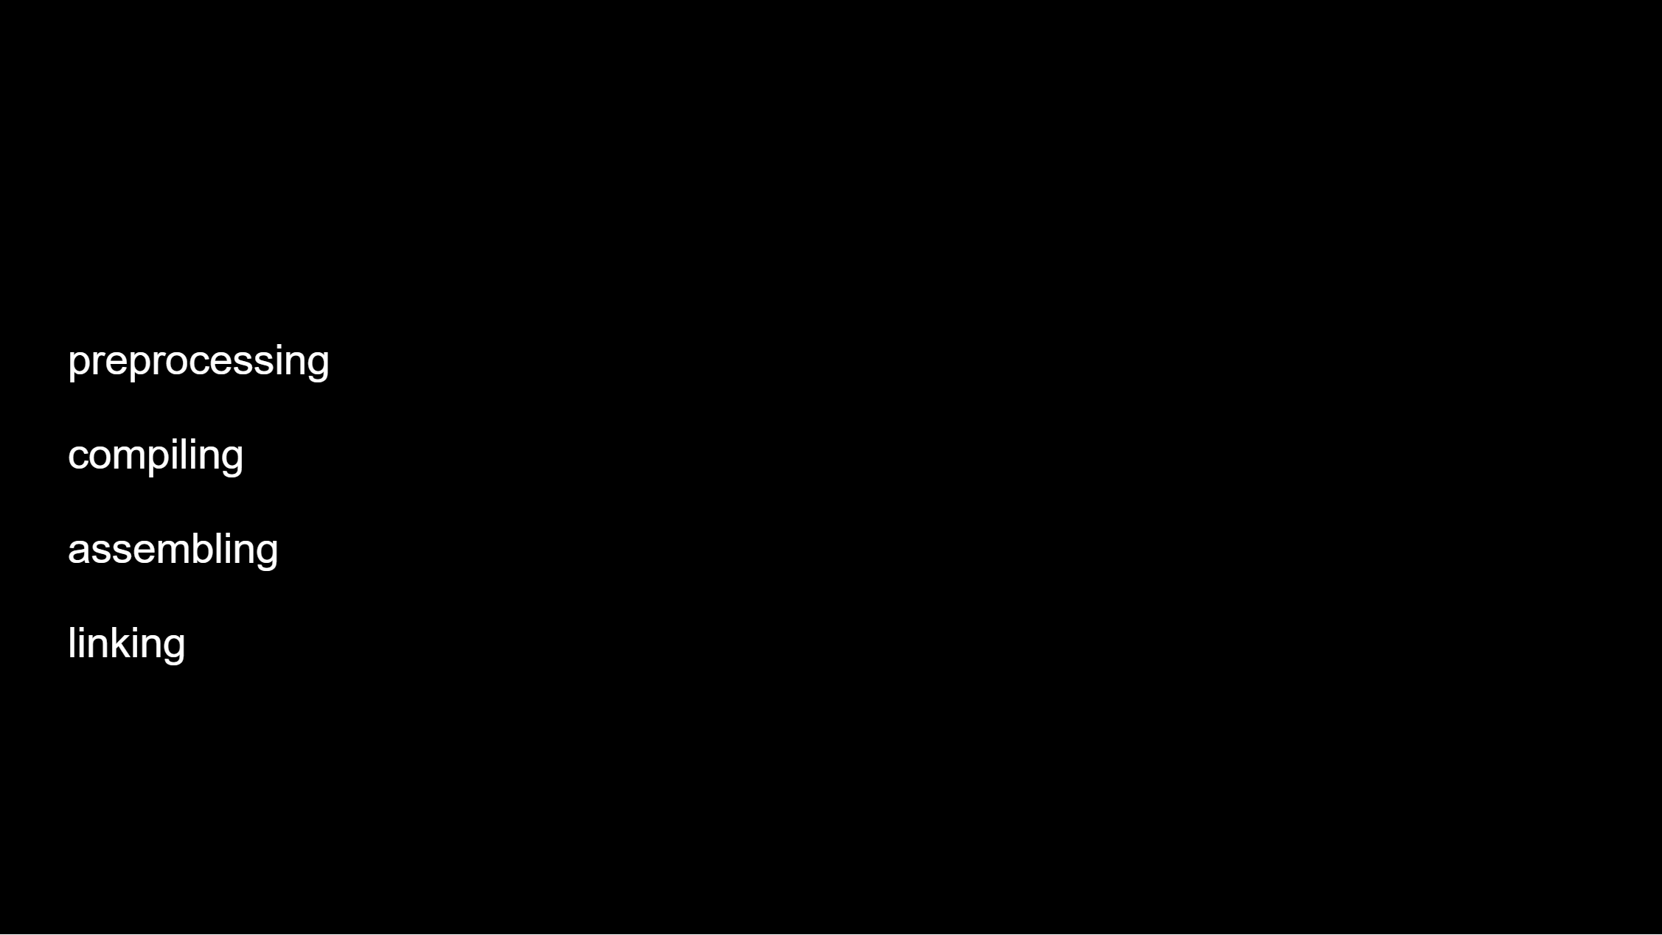
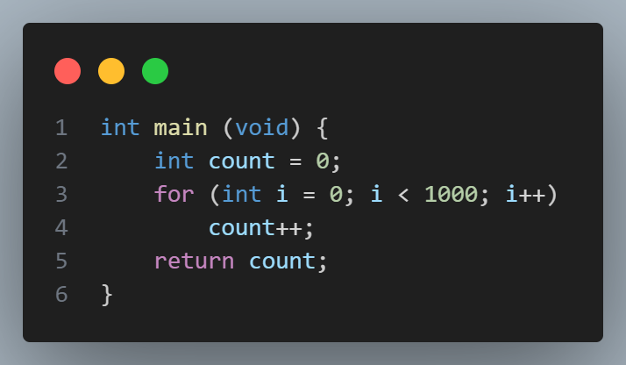
Make & compilation
Cmd-line
Let’s consider what happens when we try to compile this code:

Slide 36
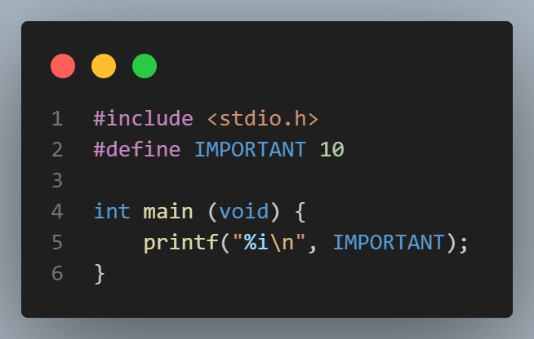
Pre-processing
Cmd-line
We can use the –E flag to see the result of the pre-processing step!

Slide 37
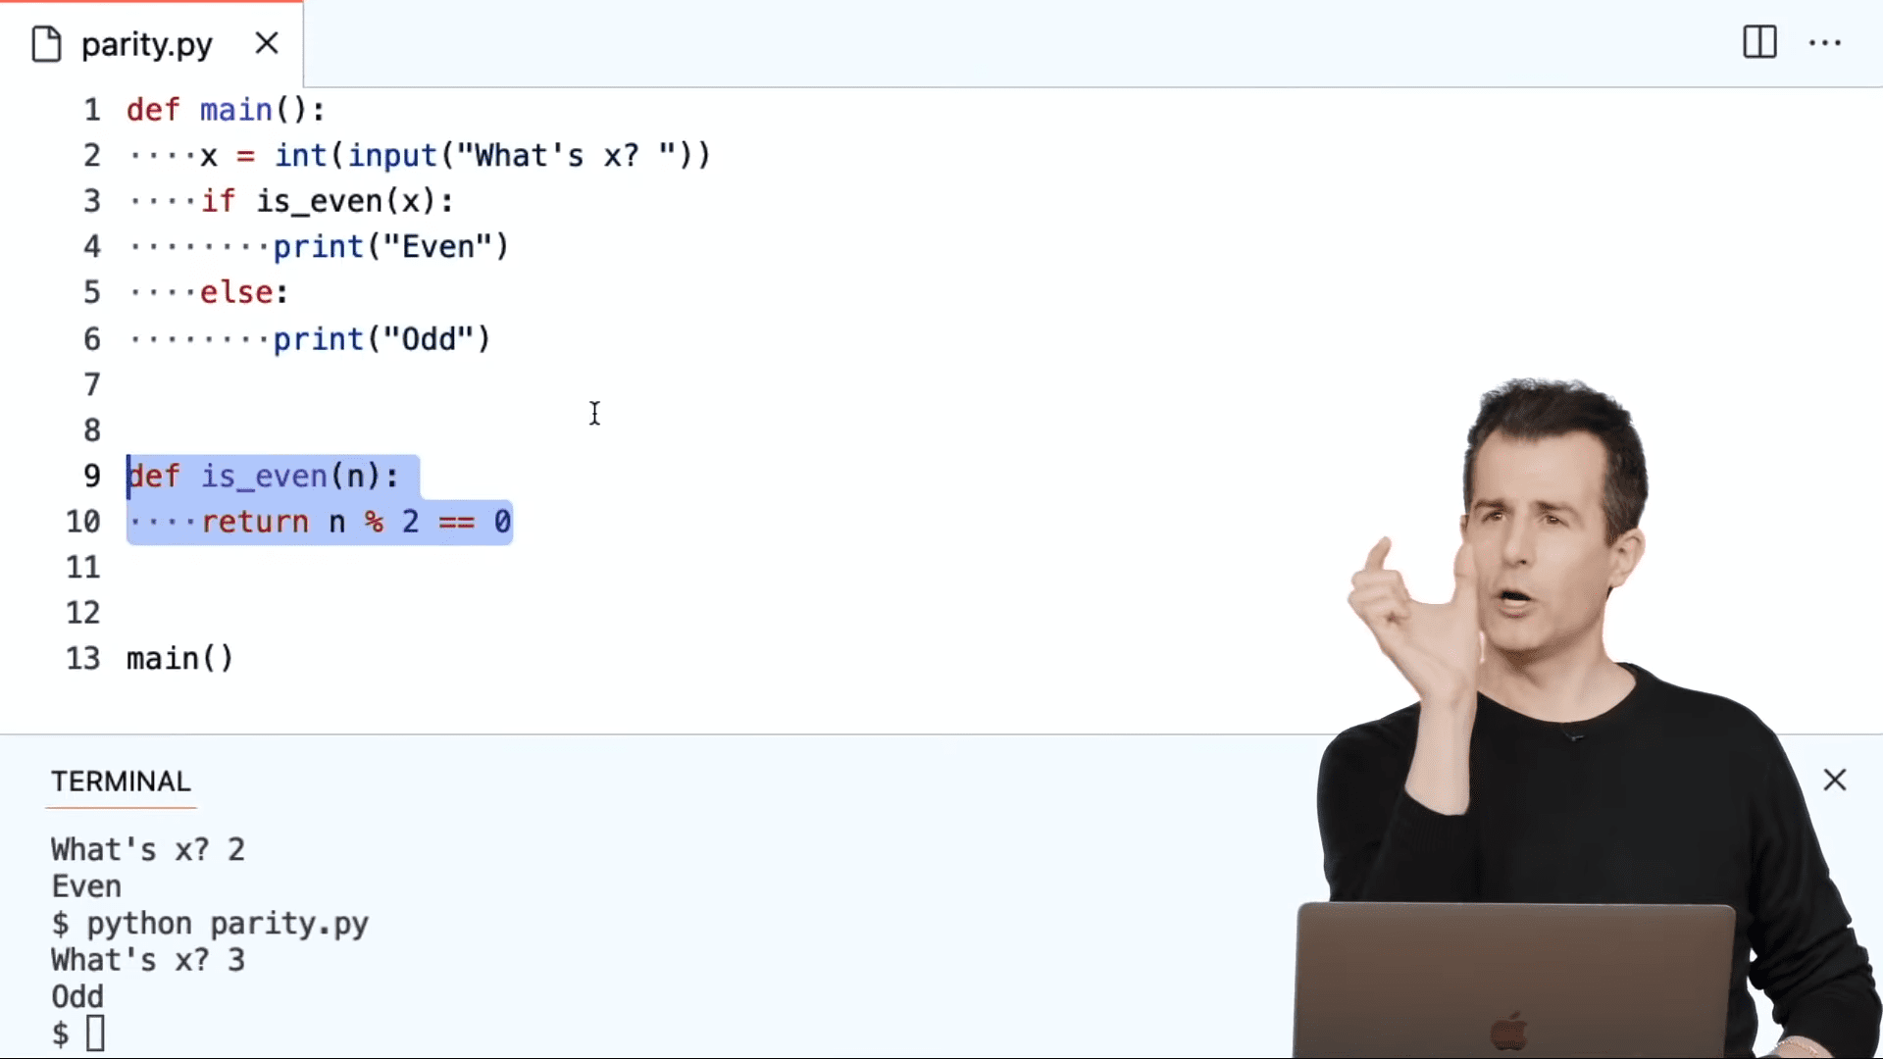
LIVE CODING NOT AS WELL AS DAVID

Slide 38
Make & compilation
Cmd-line
Let’s consider what happens when we try to compile this code:

Slide 39
Seeing the source code!
Cmd-line
call ___main
movl $0, 12(%esp)
movl $0, 8(%esp)
jmp L2
L3:
addl $1, 12(%esp)
addl $1, 8(%esp)
L2:
cmpl $999, 8(%esp)
jle L3
movl 12(%esp), %eax
leave
We can use the –S flag to compile not the object file, but the source file!
But this source code seems pretty… dumb?

Slide 40
Seeing the source code!
Cmd-line
Let’s use some optimization flags!
-O3 uses optimization level 3!
call ___main
movl $1000, %eax
leave
That’s more like it!

Slide 41
04
PSET!

Slide 42
PSET
In pairs, implement scrabble from PSET 2!
PSET!

Slide 43
PSET Advice
PSET
A number of libraries that could be useful for you, browse the manual!
Consider the design tips I gave earlier.
Be careful with float operations
Use char arithmetic where possible for clarity.

Slide 44
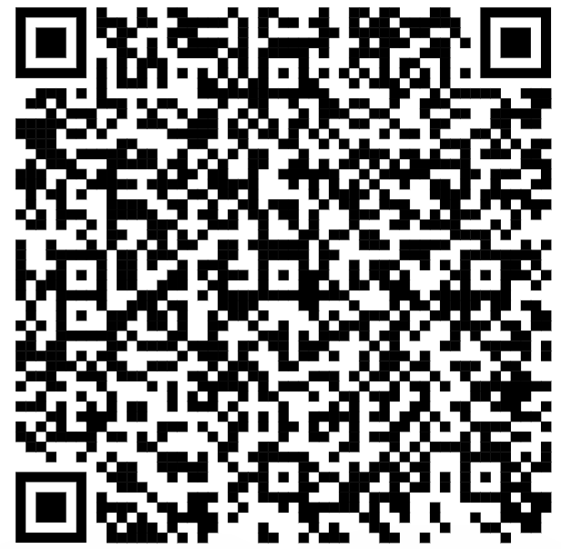
Feedback Form
If you haven’t already done so, please fill out the feedback form for section 1 (last section).

Slide 45
Attendance
Slack

Slide 46

Thanks for coming!
Happy to talk further about…
Compilers
Local set up
CS courses here
PSET questions
Grading questions
Other languages
Other stuff!

